Slide 1
Health monitoring system in cars

Slide 2
Over view of project
This system take care of any driver by Following-up heart rateand if something goes wrong an alarm will be launched , the car will stop, a GPS location will be sent for a near hospital , and a message will be sent torelative people or family..... the project is on progress and more features will be added

Slide 3
Way of thinking

Slide 4
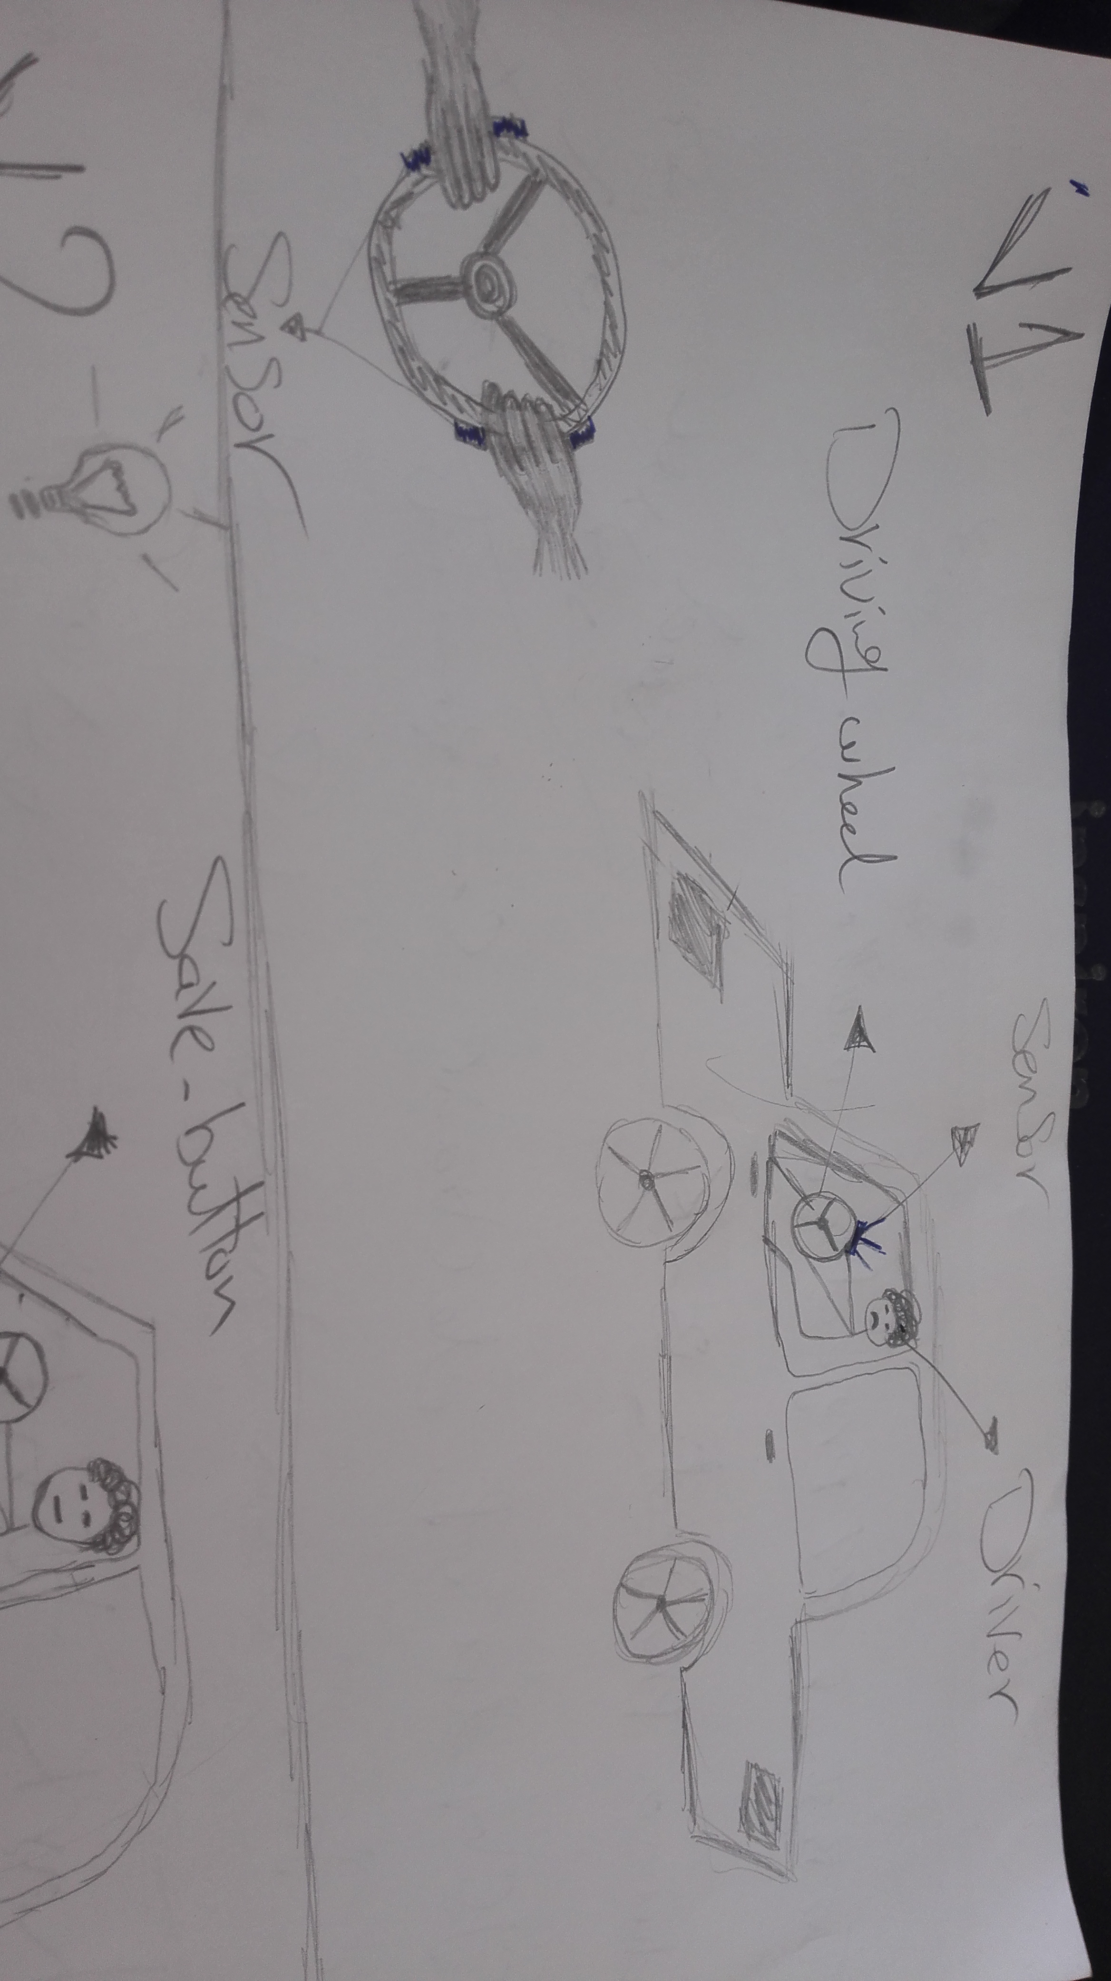
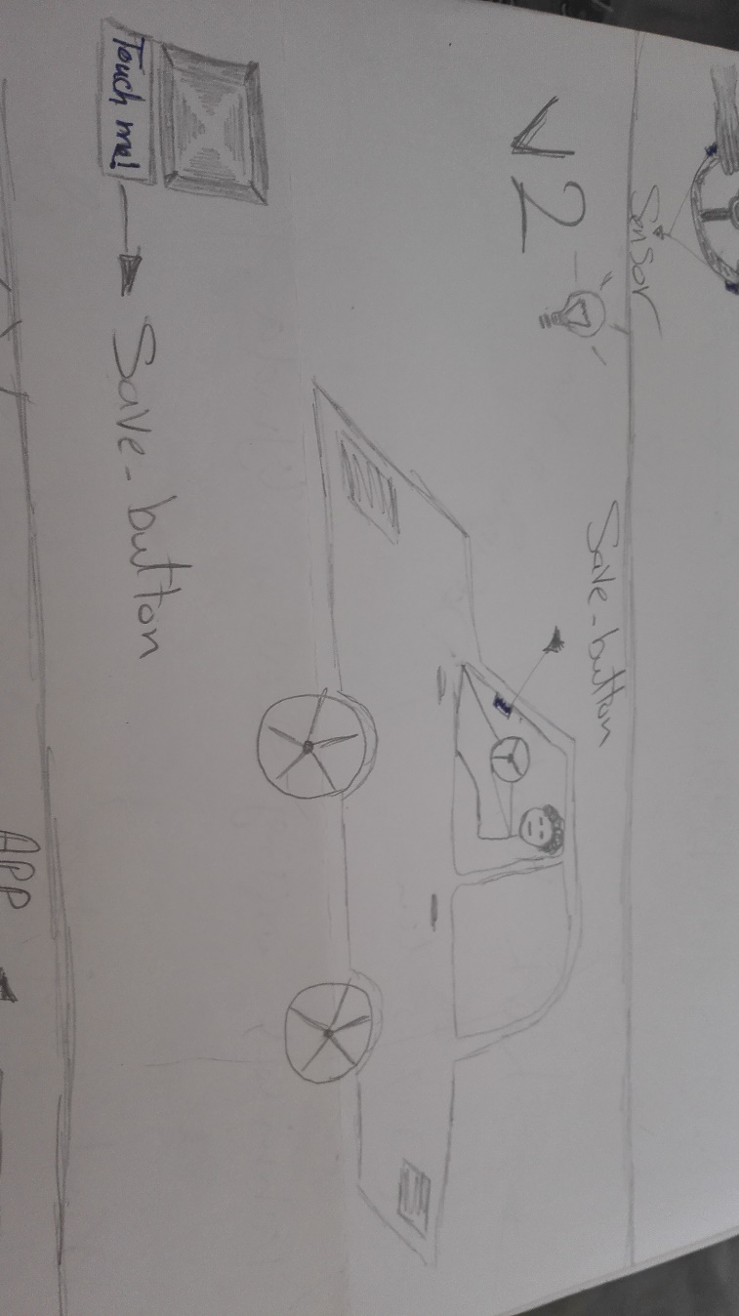
V1

Slide 5
Hardware design and implementation

Slide 6
On board

Slide 7
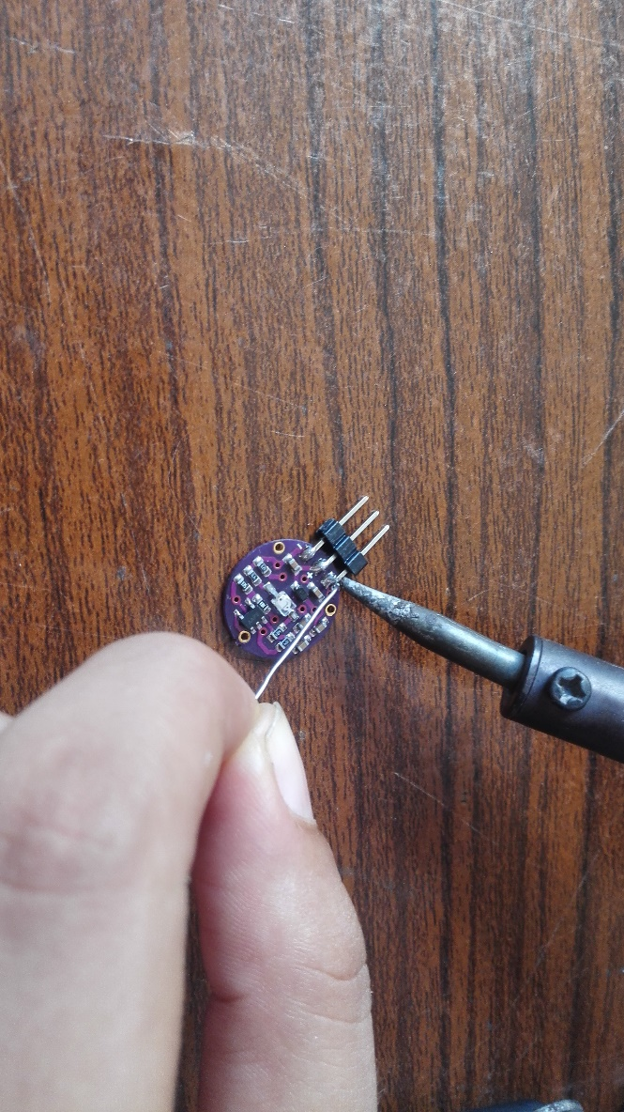
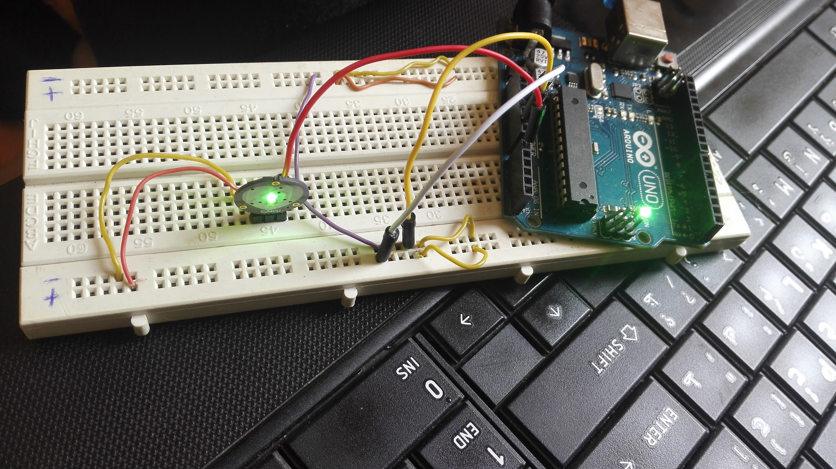

Slide 8
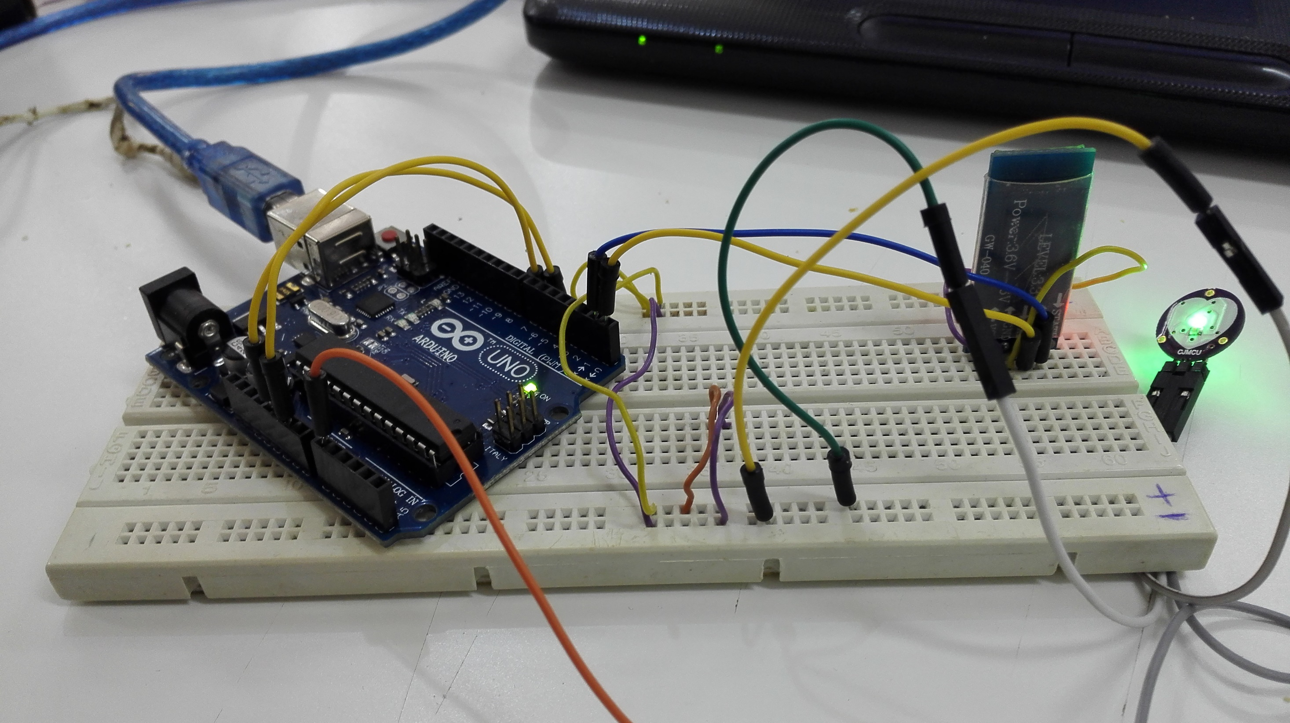

Slide 9
PCB

Slide 10
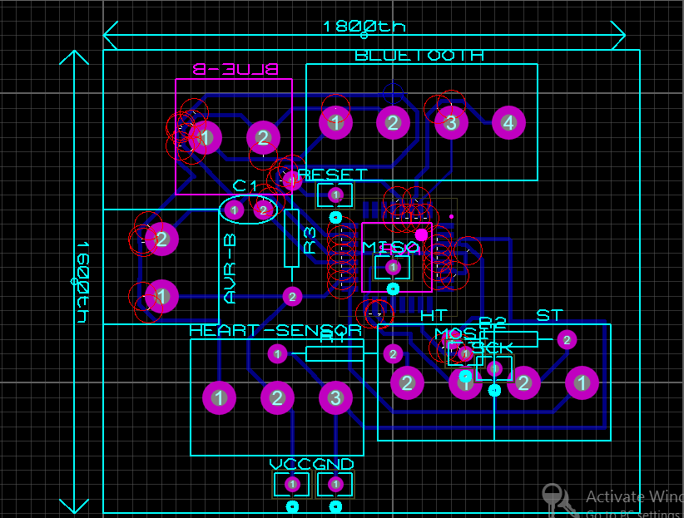
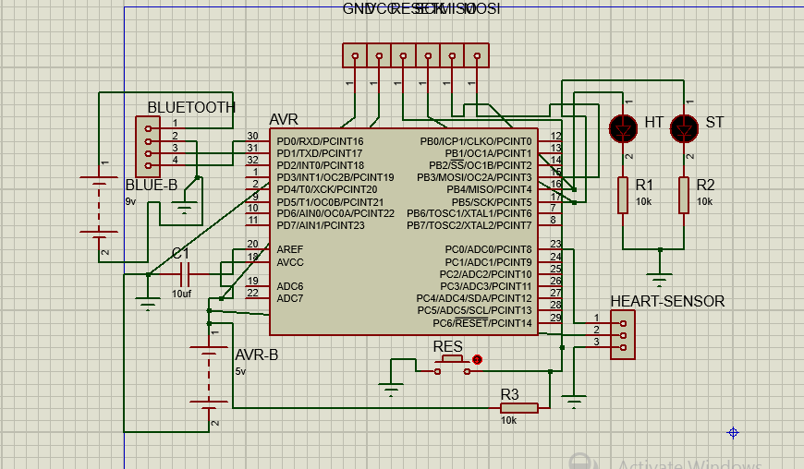

Slide 11
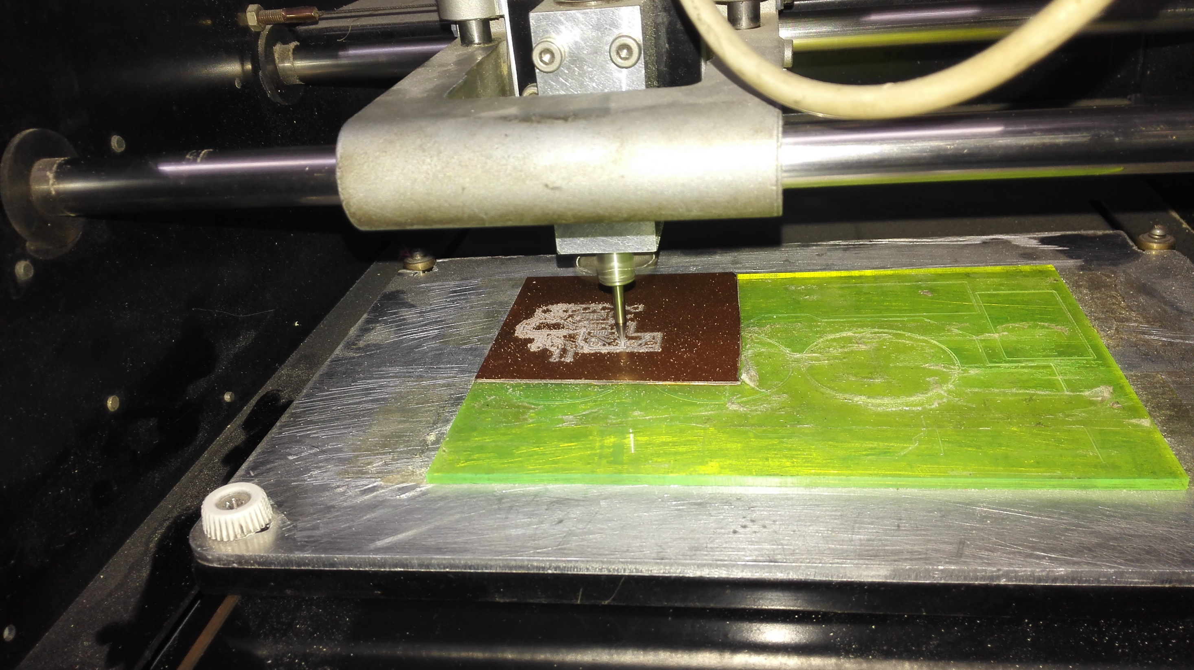

Slide 12
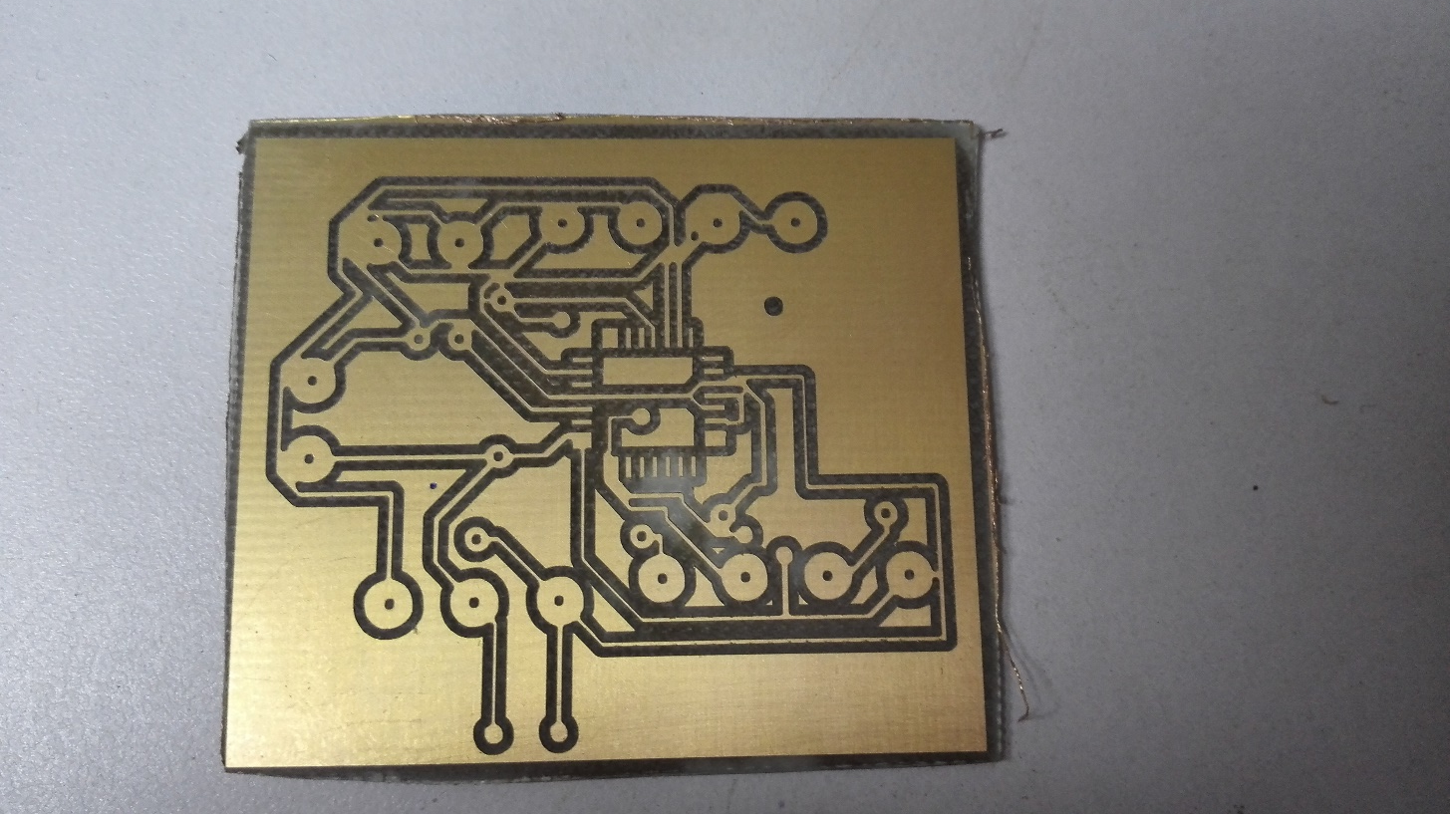
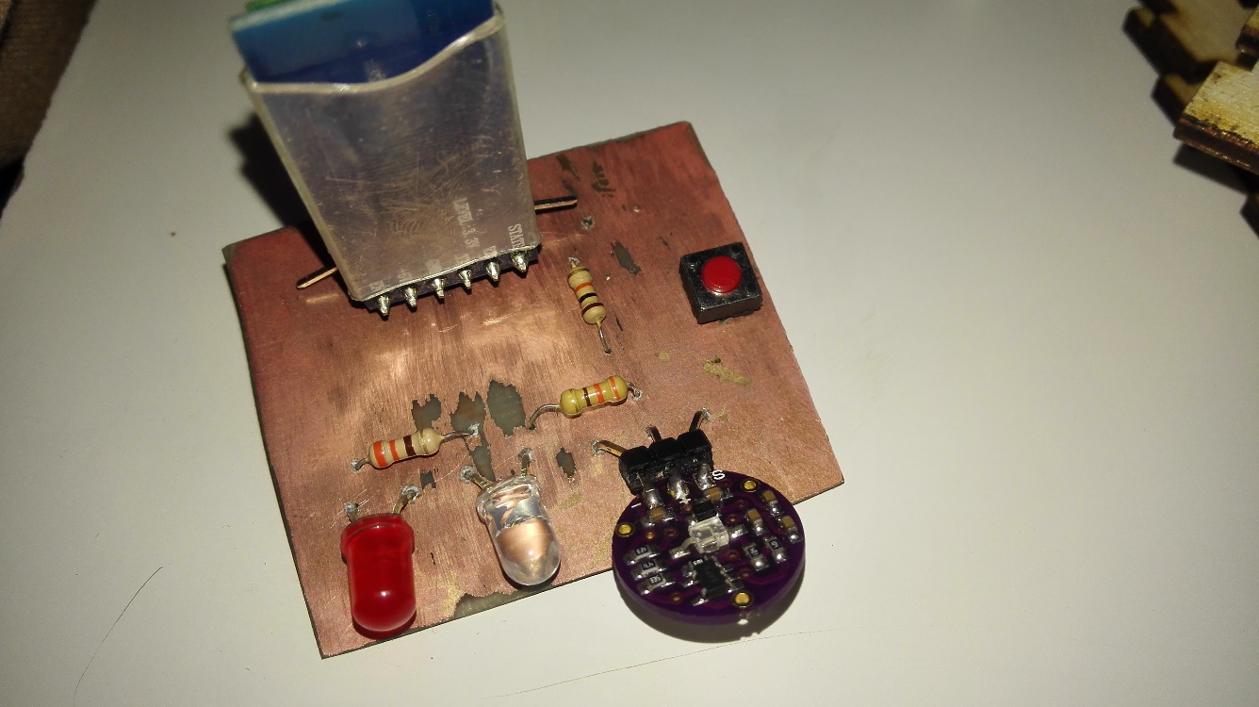

Slide 13
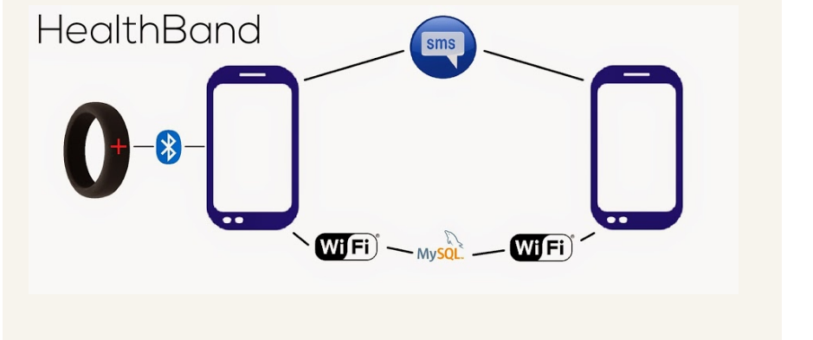
Android App
https://github.com/wafaaelmaandy/Health-monitoring-system-in-cars.git

Slide 14

Add 3 Numbers And Save Them In App
Send Automatic Message
Get Current Location
Send Location As SMS Automatically
Connect App With Bluetooth Module

Slide 15
Output

Slide 16
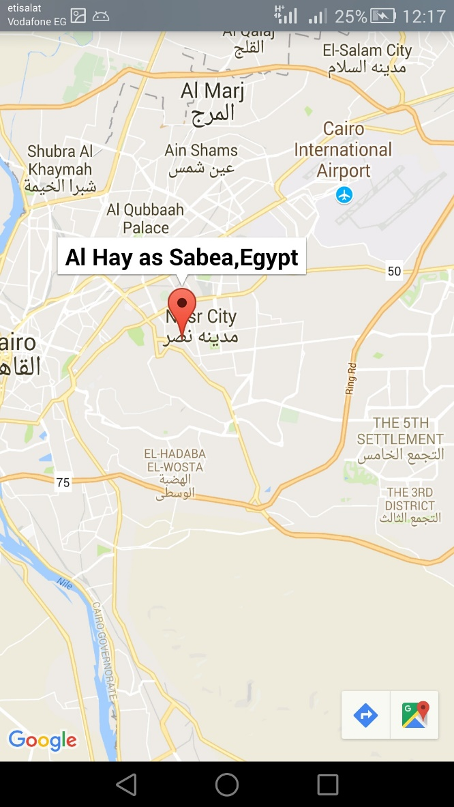
Location

Slide 17
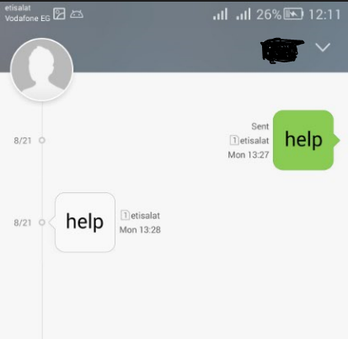
Send Massages

Slide 18
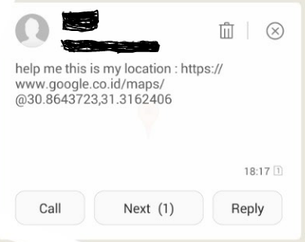
Send Location as SMS

Slide 19
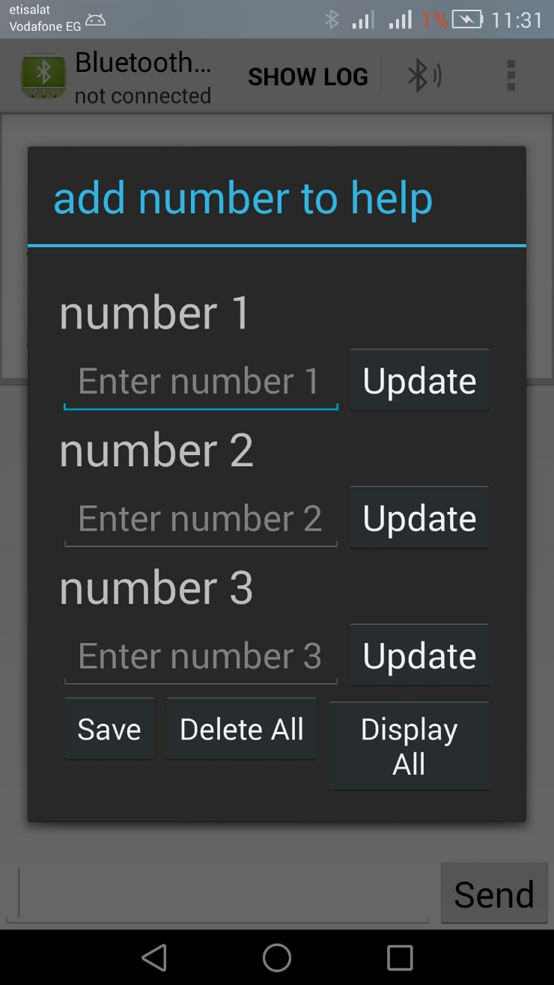
Add 3 number and save them in app

Slide 20
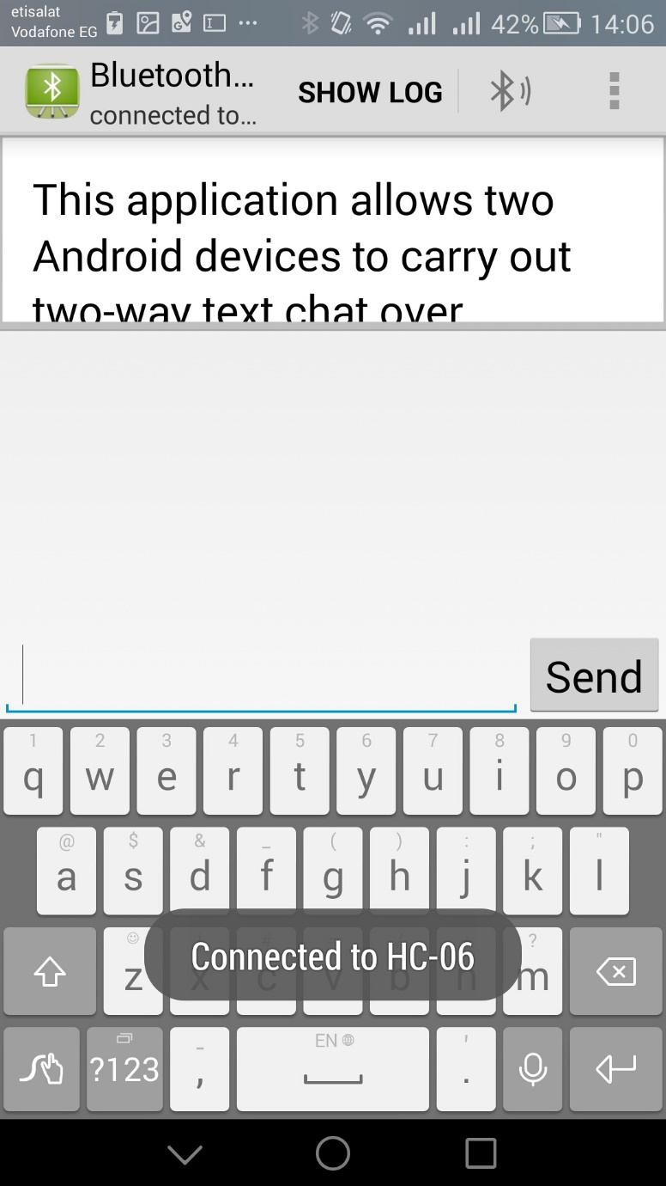
Connected to Bluetooth module

Slide 21
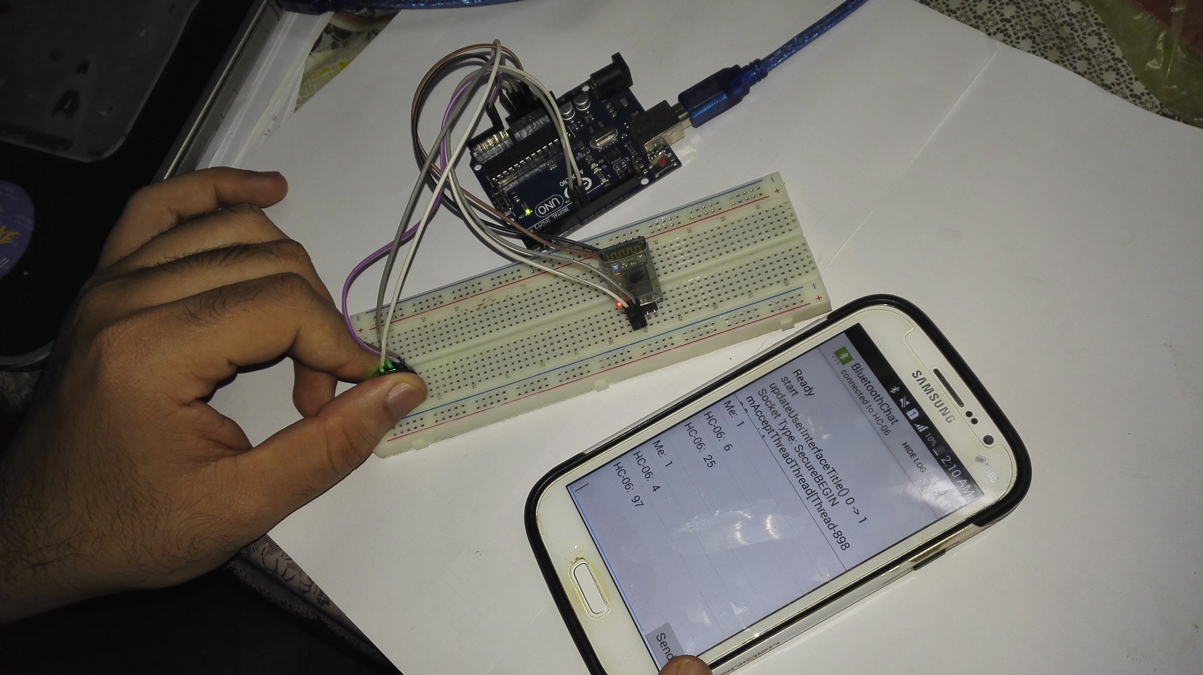
Test App With project

Slide 22
Business
Create,
Deliver
& Capture Value
Model

Slide 23
The Business Model Canvas
Car accessories shops
&Cars companies
Save lives
KEY ACTIVITIES
KEY PARTNERS
VALUE PROPOSITION
CUSTOMER RELATIONSHIP
CUSTOMER SEGMENTS
Personal Assistance
&Automated Services
Segmented
Have health problem
&old +40
&travel by himself
Mass Market
Cars companies to add this feather at all car
buying materials,
manufacturer
Materials,
Mass → technical
distributors
CHANNELS
KEY RESOURCES
Store
&Website
salary , materials , manufacturing
Asset Sale , Advertising at website &app
COST STRUCTURE
REVENUE STREAM

Slide 24

Thank you

